Slide 1

MODULE V
Graphical User Interface and Database support of Java:

Slide 2
Syllabus:
Swings fundamentals - Controller (MVC),
Swing Key Features, Model View
and
Swing Controls, Components
Containers, Swing Packages, Event Handling in Swings, Swing Layout Managers, Exploring Swings –JFrame, JLabel, The Swing Buttons, JTextField.
Java DataBase Connectivity (JDBC) - JDBC overview, Creating and Executing Queries – create table, delete, insert, select.

Slide 3
Swings
The Swing-related classes are contained in javax.swing.
Swing is a set of classes that provides more powerful and flexible GUI components than are possible with the AWT.
All components have more capabilities in Swing.
Example: A button may have both an image and a text string associated with it. Also, the image can be changed as the state of the button changes.
Swing library is an official Java GUI tool kit released by Sun Microsystems
Java Swing provides platform-independent and lightweight components

Slide 4
Java Swing is a part of Java Foundation Classes(JFC) that is used to create window-based applications.
It is built on the top of AWT and entirely written in java.
JFC
The Java Foundation Classes(JFC) are a set of GUI components which simplify the development of desktop applications.
The javax.swing package provides classes for java swing API such as JButton, JTextField, JTextArea, JRadioButton, JCheckbox, JMenu, JColorChooser etc.

Slide 5
Features of Swing (Advantages of Swings over AWT)
Platform Independent
It is platform independent, the swing component that are used to build the programs are not platform specific.
The behavior and appearance of Swing components is consistent across platforms, whereas AWT components will differ from platform to platform. Thus Swing is platform independent whereas AWT is platform dependent.
Swing Components Are Lightweight
This means that they are written entirely in Java and do not map directly to platform-specific peers.
Swing Supports a Pluggable Look and Feel
SWING based GUI Application look and feel can be changed at run-time, based on available values.

Slide 6
Swing uses MVC Architecture
Java's Swing components have been implemented using the
model-view controller (MVC) model.
Any Swing component can be viewed in terms of three independent aspects: what state it is in (its model), how it looks (its view), and what it does (its controller). Suppose the user clicks on a button. This action is detected by the controller. The controller tells the model to change into the pressed state. The model in turn generates an event that is passed to the view. The event tells the view that the button needs to be redrawn to reflect its change in state.

Slide 7
Swing uses MVC Architecture
Java's Swing components have been implemented using the
model-view controller (MVC) model.
Any Swing component can be viewed in terms of three independent aspects: what state it is in (its model), how it looks (its view), and what it does (its controller). Suppose the user clicks on a button. This action is detected by the controller. The controller tells the model to change into the pressed state. The model in turn generates an event that is passed to the view. The event tells the view that the button needs to be redrawn to reflect its change in state.
High level of separation between view and controller is not beneficial for Swing components. Instead Swing use a modified version of MVC that combines the view and controller into a single entity called UI (User Interface) delegate. For this reason ,Swing’s approach is called either the Model-Delegate architecture or Separable Model architecture.

Slide 8
Rich Controls
Swing is the latest GUI toolkit, and provides a richer set of
interface components than the AWT.
Customizable
Swing components can be given their own "look and feel“. Eg: A button may have both an image and a text string associated with it. Also, the image can be changed as the state of the button changes.
Manageable
It is easy to manage and configure. Its mechanism and composition pattern allows changing the settings at run time as well. The uniform changes can be provided to the user interface without doing any changes to application code.

Slide 9
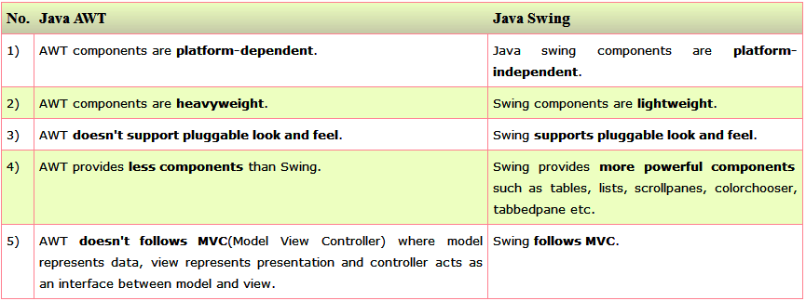
Difference between AWT and Swing

Slide 10
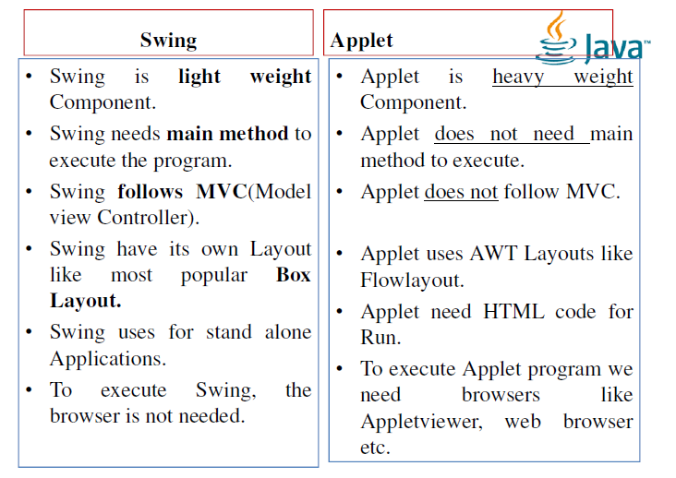

Slide 11
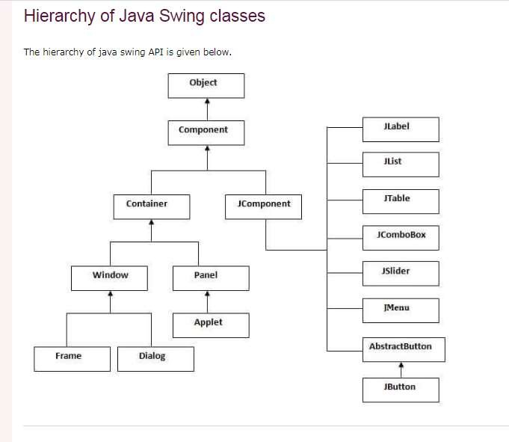

Slide 12
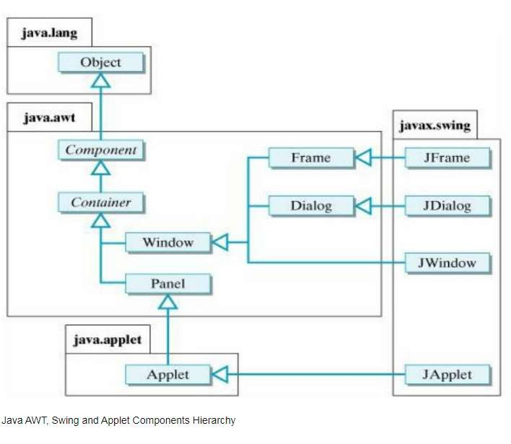

Slide 13
COMPONENTS & CONTAINERS
A component is an independent visual control, such as a push button or slider.
A container holds a group of components. Thus, a container is a special type of component that is designed to hold other components.
Swing components inherit from the javax.Swing.JComponent class, which is the root of the Swing component hierarchy.

Slide 14
Swing Components
Swing components are derived from the JComponent class.
JComponent provides the functionality that is common to all components.
Eg: JComponent supports the pluggable look and feel.
JComponent inherits the AWT classes Container and Component.
Thus a Swing component is built on and compatible with an AWT component.
All of Swing’s components are represented by classes defined within the package javax.swing.

Slide 15
Class names for Swing components(including those used as containers)
JApplet JColorChooser JDialog JFrame JLayeredPane JMenuItem JPopupMenu JRootPane JList
JProgressBar
JSlider JTable
JTogglebutton JViewport JButton JComboBox JEditorPane JInternalFrame JOptionPane

Slide 16
Swing Containers
Swing defines two types of containers.
The first are top-level containers:
Jframe,JApplet,JWindow, and JDialog.
They do not inherit JComponent.
They inherit the AWT classes Component and Container.
Unlike Swing’s other components, which are lightweight, the top level containers are heavyweight.
The one most commonly used for application is JFrame and the one used for Applet is JApplet.

Slide 17
The second type of containers supported by Swing are lightweight containers.
They inherit the JComponent.
An example of lightweight container is JPanel.
Lightweight container can be contained within another container.

Slide 18
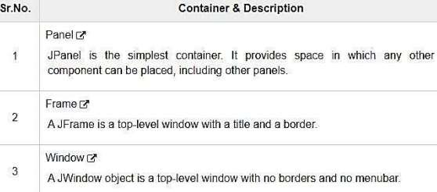
Following is the list of commonly used containers while designed GUI using SWING.

Slide 19
The Model-View-Controller Architecture
Swing uses the model-view-controller architecture (MVC) as the fundamental design behind each of its components
MVC breaks GUI components into three elements. Each of these elements plays a crucial role in how the component behaves.
The Model-View-Controller is a well known software architectural pattern ideal to implement user interfaces on computers by dividing an application intro three interconnected parts

Slide 20
Main goal of Model-View-Controller(MVC), is to separate internal representations of an application from the ways information are presented to the user.
Initially, MVC was designed for desktop GUI applications but it’s quickly become an extremely popular pattern for designing web applications too.
MVC pattern has the three components :
Model that manages data, logic and rules of the application
View that is used to present data to user
Controller that accepts input from the user and converts it to commands for the Model or View.

Slide 21
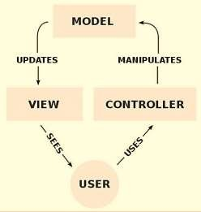
The MVC pattern defines the interactions between these three components as below:

Slide 22
The Model receives commands and data from the Controller. It stores these data and updates the View.
The View lets to present data provided by the Model to the user.
The Controller accepts inputs from the user and converts it to commands for the Model or the View.

Slide 23
EVENT HANDLING IN SWINGS
The functionality of Event Handling is what is the further step if an action performed.
Java foundation introduced “Delegation Event Model” i.e describes how to generate and control the events.
The key elements of the Delegation Event Model are source and listeners.
The listener should have registered on source for the purpose of alert notifications.
All GUI applications are event-driven

Slide 24
Java Swing event object
When something happens in the application, an event object is created.
For example, when we click on the button or select an item from a list.
There are several types of events, including ActionEvent, TextEvent, FocusEvent, and ComponentEvent.
Each of them is created under specific conditions.
An event object holds information about an event that has occurred.

Slide 25
import java.awt.*; import javax.swing.*; import java.awt.event.*;
public class Swingdemoevent implements ActionListener {
JTextField t=new JTextField(20); JButton b=new JButton("OK"); public Swingdemoevent() {
JFrame f=new JFrame();
f.add(t);
f.add(b); f.setSize(300,300)
f.setLayout(newFlowLayout()); f.setVisible(true);
b.addActionListener(this);
f.setDefaultCloseOperation(JFrame.EXIT_ON_CLOSE); }

Slide 26
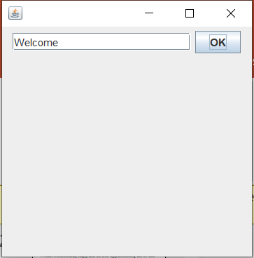
public void actionPerformed(ActionEvent e)
{
t.setText("Welcome");
}
public static void main(String args[]) {
Swingdemoevent s=new Swingdemoevent();
} }
Output

Slide 27
SWING LAYOUT MANAGERS
Layout refers to the arrangement of components within the container.
Layout is placing the components at a particular position within the container. The task of laying out the controls is done automatically by the Layout Manager.
The layout manager automatically positions all the components within the container.
Even if you do not use the layout manager, the components are still positioned by the default layout manager. It is possible to lay out the controls by hand, however, it becomes very difficult

Slide 28
Java provides various layout managers to position the controls. Properties like size, shape, and arrangement varies from one layout manager to the other.
There are following classes that represents the layout managers: java.awt.BorderLayout
java.awt.FlowLayout java.awt.GridLayout java.awt.CardLayout java.awt.GridBagLayout
javax.swing.BoxLayout javax.swing.GroupLayout javax.swing.SpringLayout etc.

Slide 29
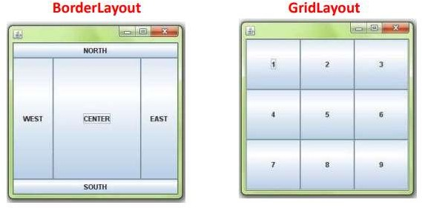
A BorderLayout places components in up to five areas: top, bottom, left, right, and center. All extra space is placed in the center area.
GridLayout makes a bunch of components equal in size and displays them in the requested number of rows and columns.

Slide 30
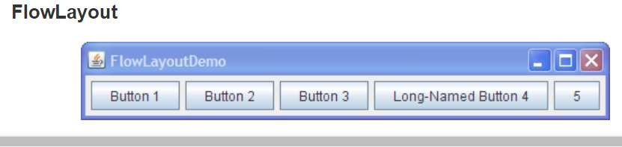
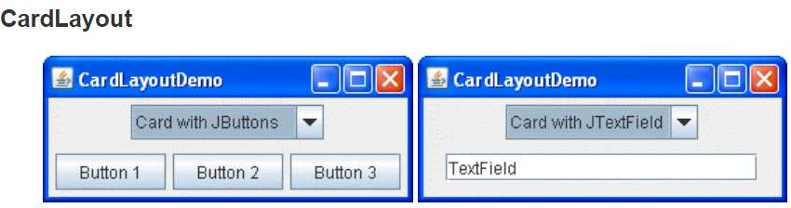
FlowLayout is the default layout manager for every JPanel. It simply lays out components in a single row, starting a new row if its container is not sufficiently wide.
The CardLayout class lets you implement an area that contains different components at different times. A CardLayout is often controlled by a combo box, with the state of the combo box determining which panel (group of components) the CardLayout displays.

Slide 31
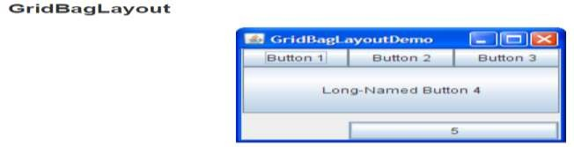
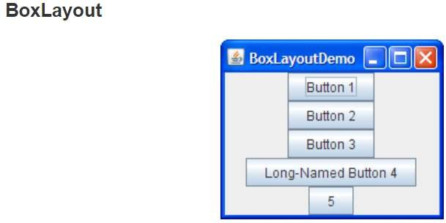
GridBagLayout is a sophisticated, flexible layout manager. It aligns components by placing them within a grid of cells, allowing components to span more than one cell.The rows in the grid can have different heights, and grid columns can have different widths.
The BoxLayout class puts components in a single row or column. It respects the components' requested maximum sizes and also lets you align components.

Slide 32
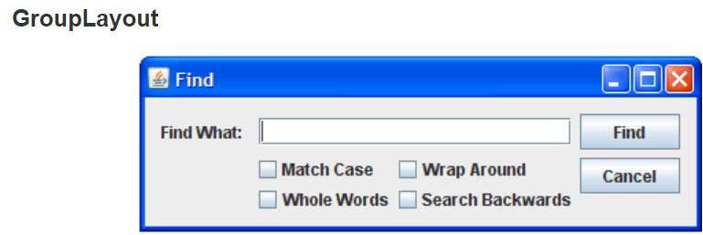
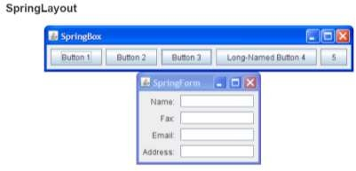
GroupLayout works with the horizontal and vertical layouts separately.The layout is defined for each dimension independently.
SpringLayout lays out the children of its associated container according to a set of constraints

Slide 33
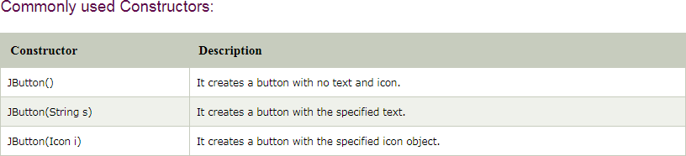
JButton
JButton extends AbstractButton class

Slide 34
Commonly used Methods of AbstractButton class:
void setText(String s): It is used to set specified text on button
String getText(): It is used to return the text of the button.
void setEnabled(boolean b): It is used to enable or disable the button.
void setIcon(Icon b): It is used to set the specified Icon on the button.
Icon getIcon(): It is used to get the Icon of the button.
void addActionListener(ActionListener a): It is used to add the action listener to this object.

Slide 35
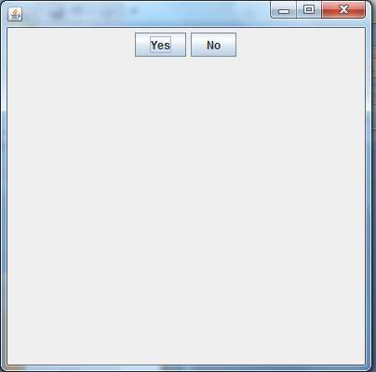
Example (JButton) import javax.swing.*; import java.awt.event.*; import java.awt.*;
public class testswing extends JFrame{
testswing(){
JButton bt1 = new JButton("Yes");
JButton bt2 = new JButton("No"); setDefaultCloseOperation(JFrame.EXIT_ON_CLOSE); setLayout(new FlowLayout());
setSize(400, 400);
add(bt1);
add(bt2); setVisible(true); }
public static void main(String[] args) {
new testswing(); } }

Slide 36
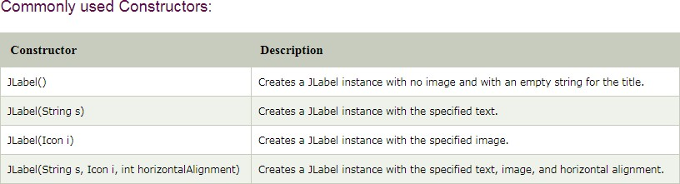
JLabel It is used for placing text in a box
Here Icon is abstract class that cannot be instantiated. ImageIcon is a class that extends Icon. So to load images the following statement can be used:
ImageIcon ic=new ImageIcon(“filename”);
where filename is a string quantity.

Slide 37
Commonly used Methods of JLabel class:
String getText(): It returns the text string that a label displays.
void setText(String text): It defines the single line of text this component will display.
void setHorizontalAlignment(int alignment): It sets the alignment of the label's contents along the X axis.
Icon getIcon(): It returns the graphic image that the label displays.
int getHorizontalAlignment(): It returns the alignment of the label's contents along the X axis.

Slide 38
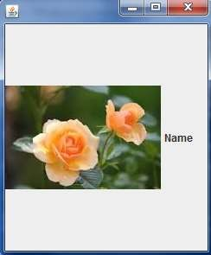
Example (JLabel)
import javax.swing.*;
public class SimpleLabel extends JFrame
{ SimpleLabel()
{ ImageIcon ic=new ImageIcon("download.jpg"); JLabel jl=new JLabel("Name",ic,JLabel.LEFT); setSize(250,300);
setVisible(true); add(jl);
setDefaultCloseOperation(JFrame.EXIT_ON_CLOSE);
}
public static void main(String args[])
{
new SimpleLabel();
}
}

Slide 39
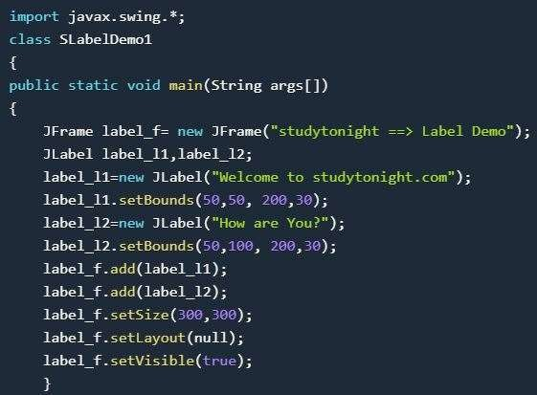
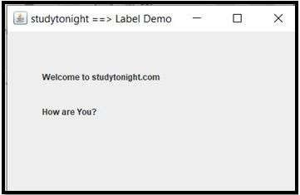

Example of Jlabel - It is used for placing text in a box

Slide 40
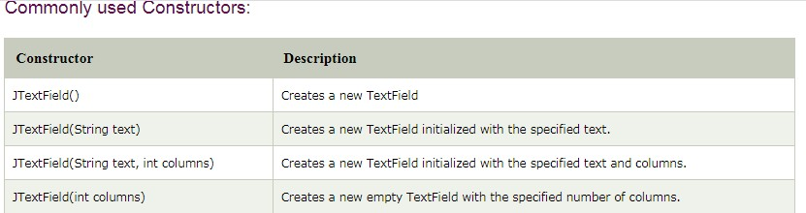
JTextField

Slide 41
Commonly used Methods of JTextField class:
void addActionListener(ActionListener l): It is used to add the specified action listener to receive action events from this textfield.
void setFont(Font f): It is used to set the current font.
void removeActionListener(ActionListener l): It is used to remove the specified action listener so that it no longer receives action events from this textfield.

Slide 42
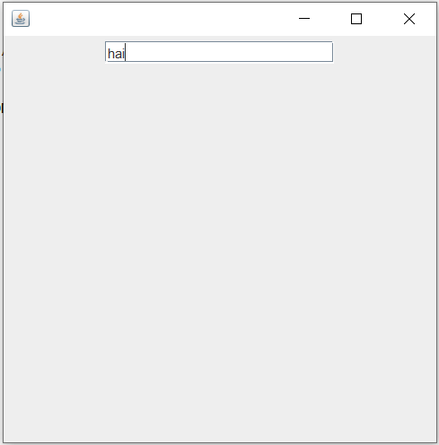
Example (JTextField) import javax.swing.*; import java.awt.event.*; import java.awt.*;
public class MyTextField extends JFrame {
public MyTextField() {
JTextField jtf = new JTextField(20); //creating JTextField.
add(jtf); //adding JTextField to frame. setLayout(new FlowLayout());
setDefaultCloseOperation(JFrame.EXIT_ON_CLOSE);
setSize(400, 400);
setVisible(true); }
public static void main(String[] args)
{
new MyTextField();
} }

Slide 43
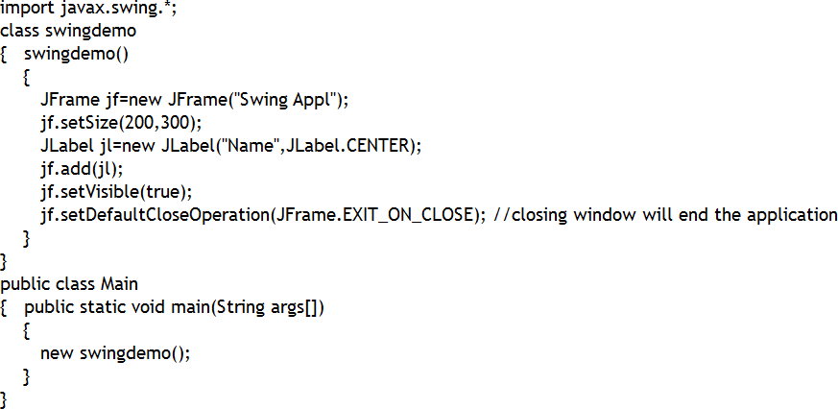
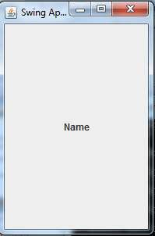
Example (JFrame and JLabel )

